Slide 1
Naïve Bayes Classifier

Slide 2
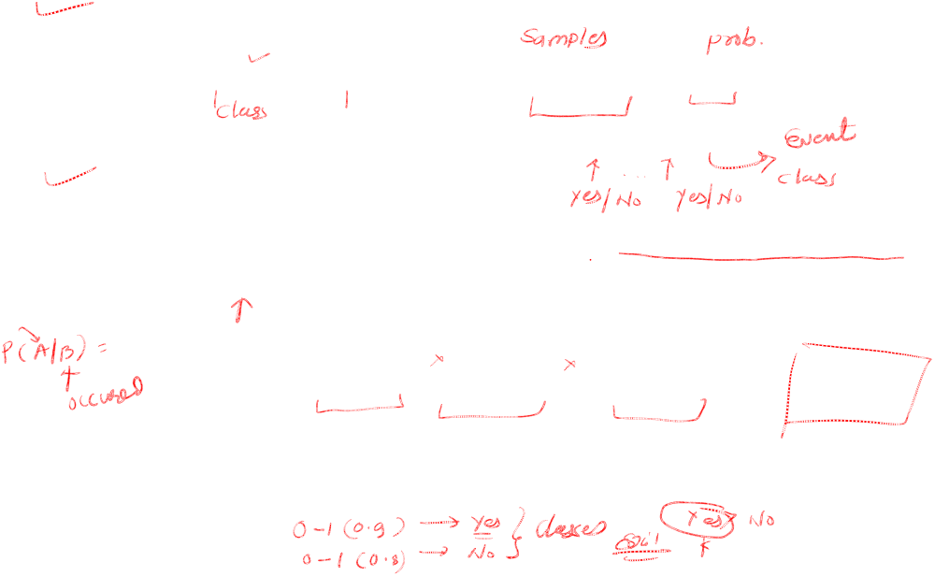

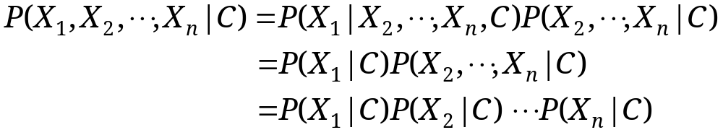
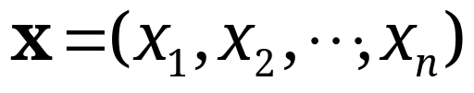
Naïve Bayes
For a class, the previous generative model can be decomposed by n generative models of a single input.
Bayes classification
  Difficulty: learning the joint probability
Naïve Bayes classification
  Assumption that all input attributes are conditionally independent!
  MAP classification rule: for
Product of individual probabilities

Slide 3
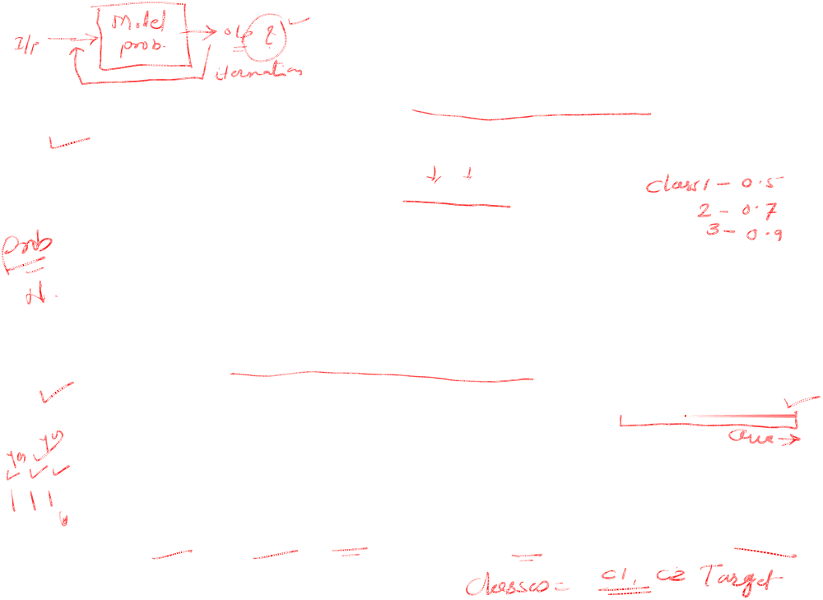
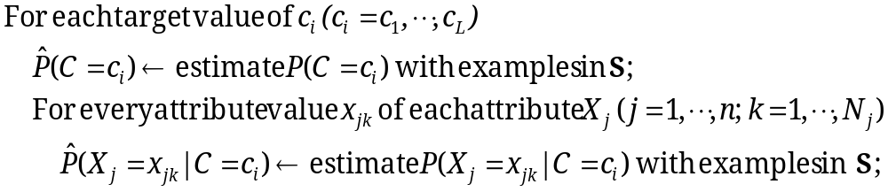


Naïve Bayes
Naïve Bayes Algorithm (for discrete input attributes) has two phases
  1. Learning Phase: Given a training set S,
  Output: conditional probability tables; for elements
  2. Test Phase: Given an unknown instance ,
  Look up tables to assign the label c* to X’ if

Slide 4
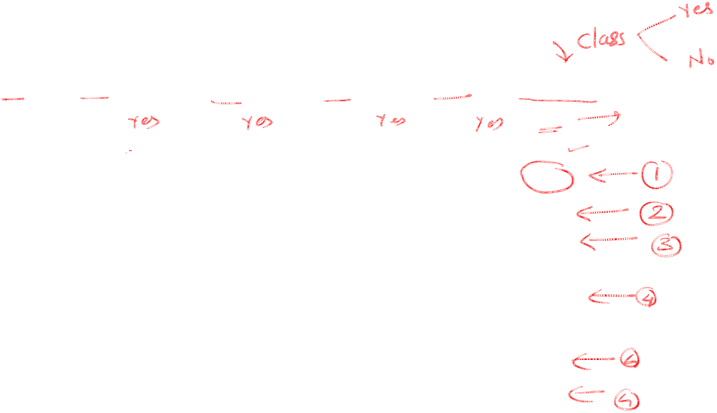

Tennis Example
Example: Play Tennis

Slide 5

The learning phase for tennis example
P(Play=Yes) = 9/14
P(Play=No) = 5/14
We have four variables, we calculate for each
Outlook | Play=Yes | Play=No
Sunny | 2/9 | 3/5
Overcast | 4/9 | 0/5
Rain | 3/9 | 2/5
Temperature | Play=Yes | Play=No
Hot | 2/9 | 2/5
Mild | 4/9 | 2/5
Cool | 3/9 | 1/5
Humidity | Play=Yes | Play=No
High | 3/9 | 4/5
Normal | 6/9 | 1/5
Wind | Play=Yes | Play=No
Strong | 3/9 | 3/5
Weak | 6/9 | 2/5

Slide 6
Problem
Given the data as found in last slide:
Find for a new point in space (vector of values) to which group it belongs (classify)

Slide 7

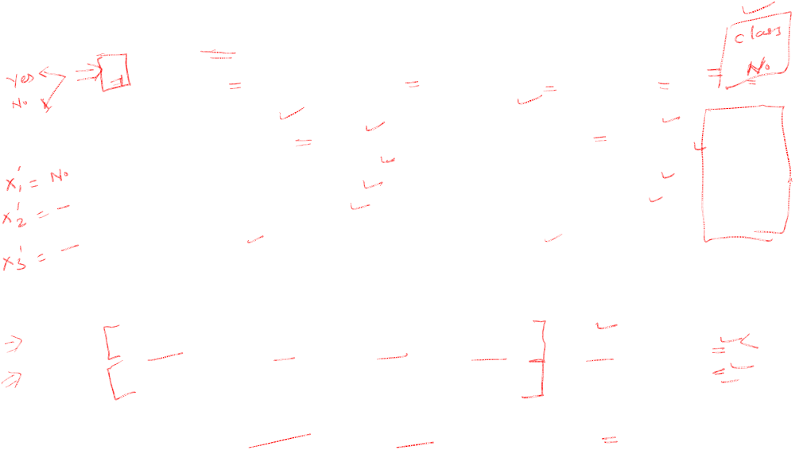
The test phase for the tennis example
Test Phase
  Given a new instance of variable values,
  x’=(Outlook=Sunny, Temperature=Cool, Humidity=High, Wind=Strong)
  Given calculated Look up tables
  Use the MAP rule to calculate Yes or No
P(Outlook=Sunny|Play=Yes) = 2/9
P(Temperature=Cool|Play=Yes) = 3/9
P(Huminity=High|Play=Yes) = 3/9
P(Wind=Strong|Play=Yes) = 3/9
P(Play=Yes) = 9/14
P(Outlook=Sunny|Play=No) = 3/5
P(Temperature=Cool|Play==No) = 1/5
P(Huminity=High|Play=No) = 4/5
P(Wind=Strong|Play=No) = 3/5
P(Play=No) = 5/14
P(Yes|x’): [P(Sunny|Yes)P(Cool|Yes)P(High|Yes)P(Strong|Yes)]P(Play=Yes) = 0.0053
P(No|x’): [P(Sunny|No) P(Cool|No)P(High|No)P(Strong|No)]P(Play=No) = 0.0206
Given the fact P(Yes|x’) < P(No|x’), we label x’ to be “No”.

